Slide 1
Chapter 3
Methods of Analysis

Slide 2
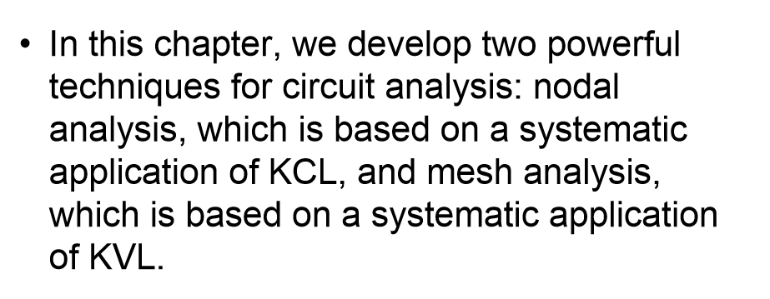
Judging the circuit to use the proper method
Using the proper method will save time

Slide 3

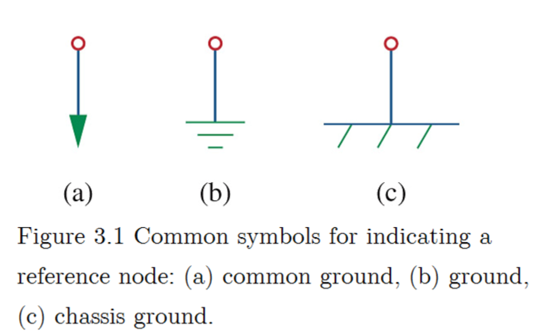
Select a node as the reference node ( commonly called the ground).
Assign node voltages v1, v2, v3, … to the remaining n-1 nodes.
Apply KCL to each node and calculate the unknown voltages.

Slide 4
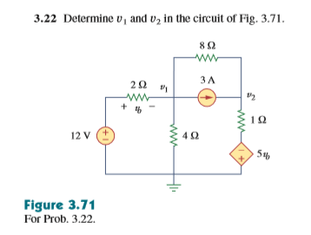

Slide 5
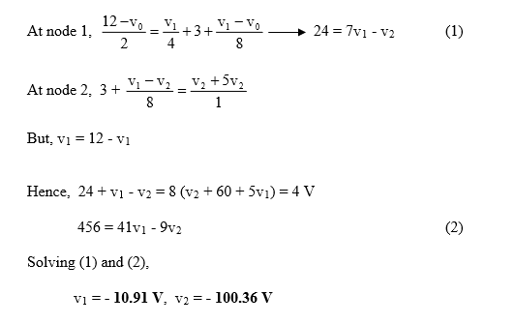

Slide 6

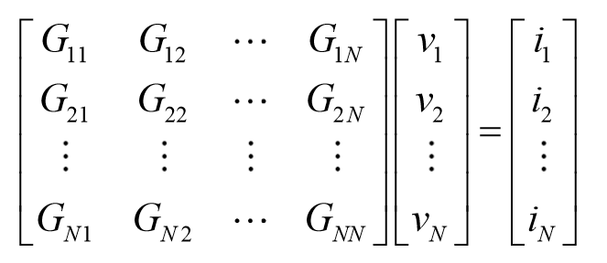
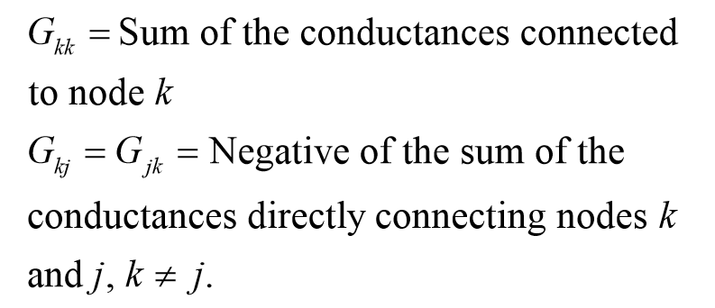

Use sample to understand how to construct the formula

Slide 7
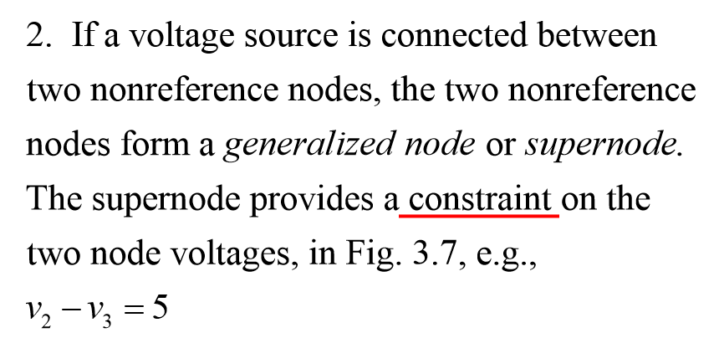
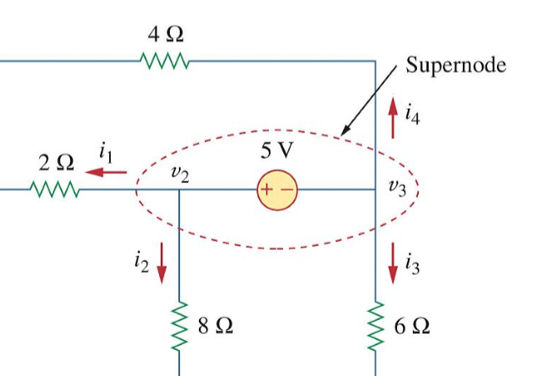
Super Node

Slide 8
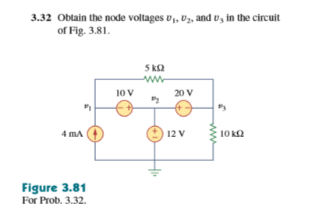

Slide 9
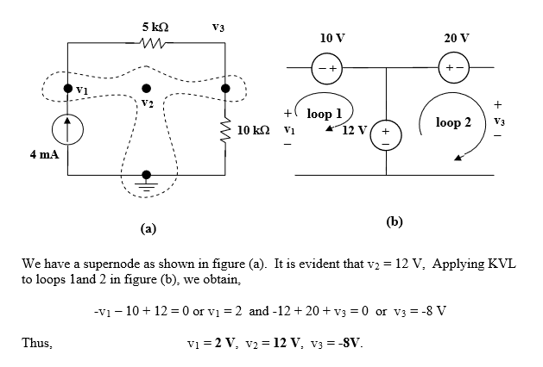

Slide 10


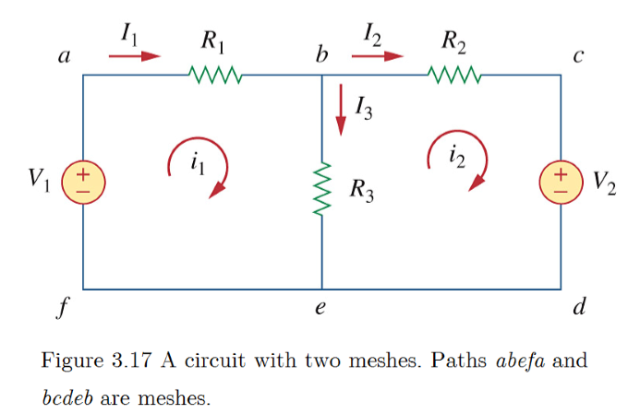
Assign mesh currents i1, i2, i3, … to the meshes.
Apply KVL to each of the meshes.
Solve the resulting simultaneous equations to get the mesh currents.

Slide 11

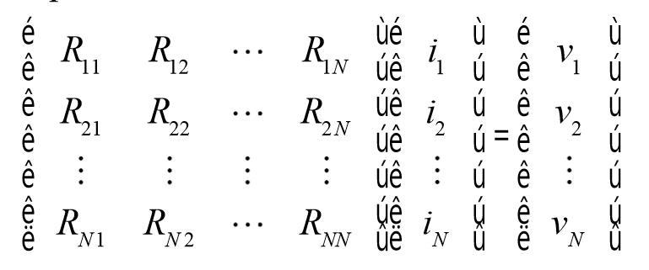
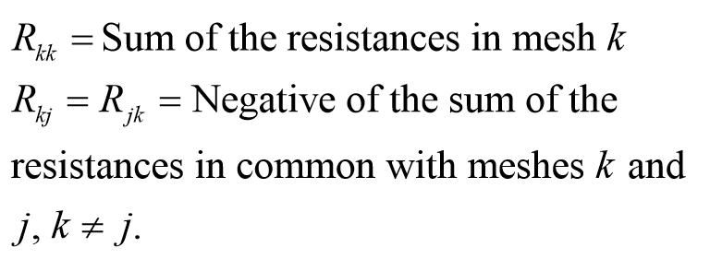



Slide 12
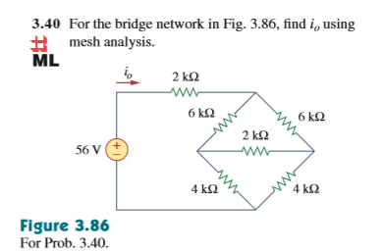

Slide 13
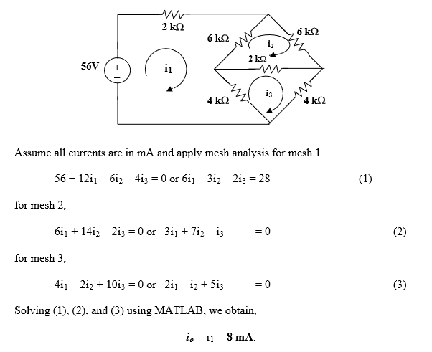

Slide 14
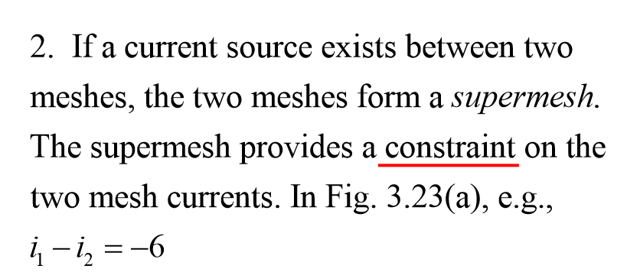
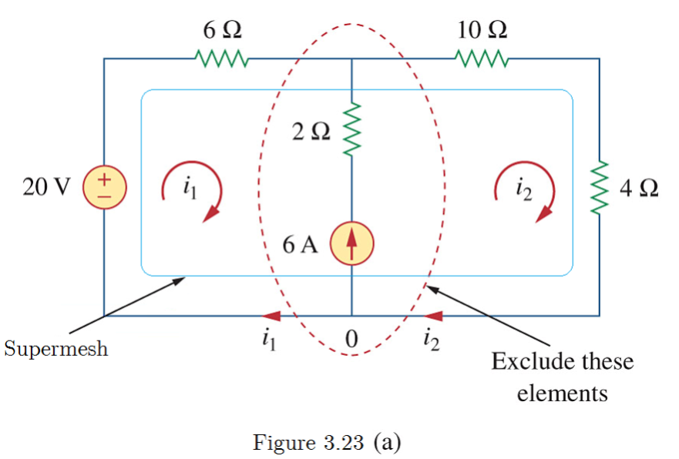
Super Node

Slide 15
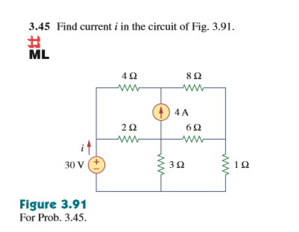

Slide 16
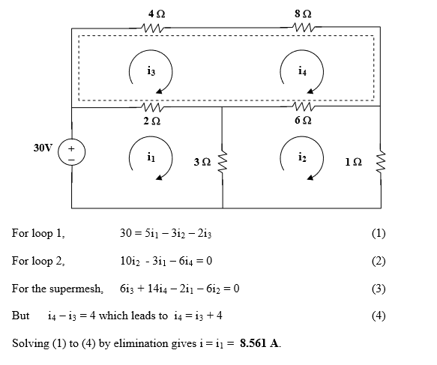

Slide 17
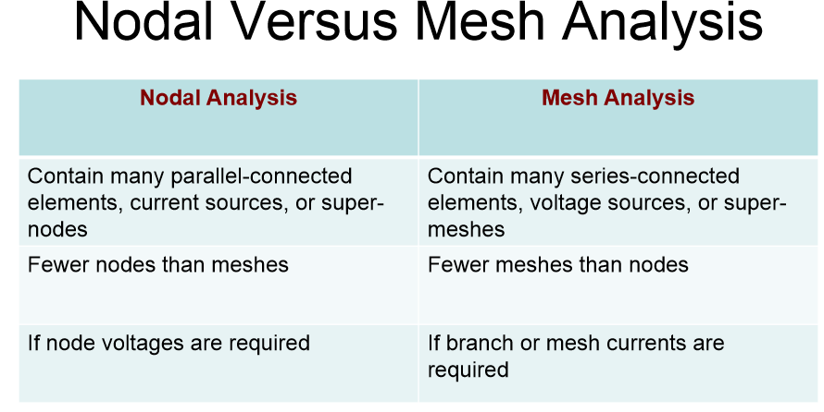
Choose one with simpler calculations

Slide 18
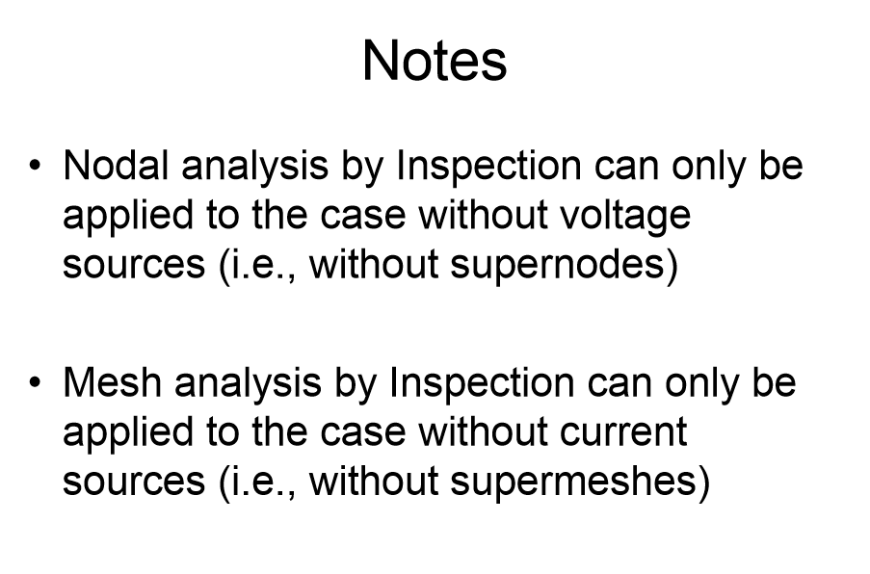
Try the easy method first

